Slide 1
WEEK 2B
Evaluating Classification
Model Performance
PROBABILITY
THRESHOLD
METRICS
Explainer Video • Binary Classification • Thresholds • Confusion Matrices
Kingsley Kojo Kpoku

Slide 2
1. What is the goal?
The model is already built. My job is to evaluate how well it classifies penguins.
MODEL
DECISION
QUESTION
The model gives a probability:
“.pred_female” = probability that a penguin is female.
A threshold turns the probability into a class:
Above threshold → Female
Below threshold → Not Female
Does changing the threshold change the model’s performance?
That is the main idea of this assignment.

Slide 3
2. Start with the baseline
Before judging the model, I need something simple to compare it against.
NULL ERROR RATE
SIMPLE MAJORITY GUESS
41.9%
41.9% error
If I always predicted the majority class, I would be wrong about 41.9% of the time.
REAL MODEL
Compare its error and performance against the baseline.

Slide 4
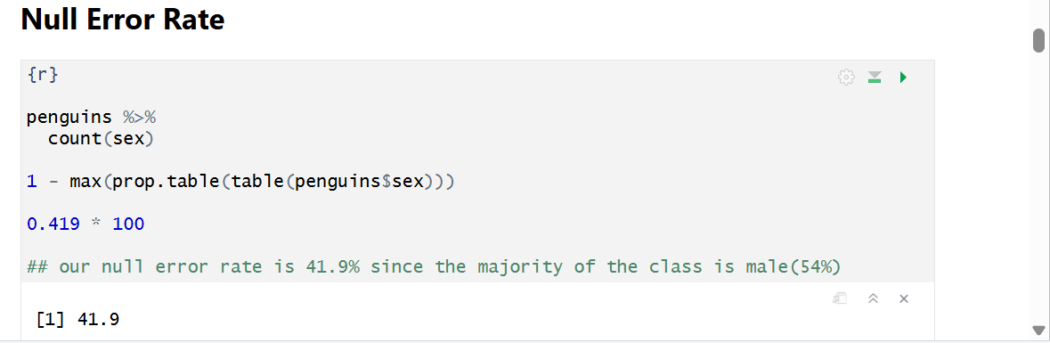
CODE BASE – NULL ERROR RATE

Slide 5
3. Probability → threshold → prediction
The same probability can lead to different decisions depending on the threshold.
0
1
0.2
0.5
0.8
0.2
0.5
0.8
More positive predictions
Middle decision point
Fewer positive predictions

Slide 6
4. The confusion matrix
Every prediction falls into one of four boxes.
TRUE POSITIVE
FALSE POSITIVE
Predicted female
Actually female
Predicted female
Actually male
FALSE NEGATIVE
TRUE NEGATIVE
Predicted not female
Actually female
Predicted not female
Actually male

Slide 7
5. My 0.8 threshold results
At the 0.8 threshold, the model produced these four outcomes.
TP
FP
36
Correctly predicted female
2
Predicted female, actually male
TN
FN
52
Correctly predicted male
3
Predicted male, actually female
Total observations = 36 + 2 + 52 + 3 = 93

Slide 8
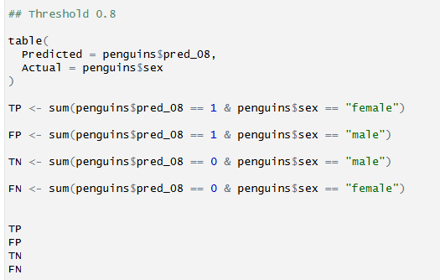
CODE BASE – 0.8 Threshold

Slide 9
6. Turn the four boxes into metrics
The metrics summarize different aspects of the model.
ACCURACY
PRECISION
RECALL
F1 SCORE
How often was the model correct?
(TP + TN) / Total
When the model predicted female, how often was it right?
TP / (TP + FP)
How many actual females did the model find?
TP / (TP + FN)
Balances precision and recall.
2 × (P × R) / (P + R)

Slide 10
7. My 0.8 threshold metrics
Using the 0.8 confusion-matrix values:
Accuracy
Precision
Recall
F1 Score
94.62%
94.74%
92.31%
93.51%
These metrics describe different parts of model performance.

Slide 11
8. Compare the thresholds
The assignment evaluates 0.2, 0.5, and 0.8 to show the threshold trade-off.
0.2
0.5
0.8
Lower threshold
Middle threshold
Higher threshold
More positive predictions
Reference point
Fewer positive predictions
Changing the threshold changes what counts as an error.

Slide 12
9. Real-world meaning
The appropriate threshold depends on what type of mistake matters most.
WHEN 0.2 CAN BE USEFUL
WHEN 0.8 CAN BE USEFUL
If missing a positive case is costly, a lower threshold can help identify more possible positive cases — even though it may create more false positives.
If false positives are costly, a higher threshold can require stronger evidence before classifying an observation as positive.
There is no universally best threshold. Context matters.

Slide 13
10. Final takeaway
What I learned from the analysis
1
2
3
4
5
Baseline
Thresholds
Confusion Matrix
Metrics
Context
Null error rate = 41.9%
0.2, 0.5, and 0.8 change predictions
TP, FP, TN, and FN show the errors
Accuracy, precision, recall, and F1 summarize performance
Threshold choice depends on model purpose
The goal was not just to calculate numbers — it was to understand how a classification model behaves when the decision threshold changes.

